Slide 1







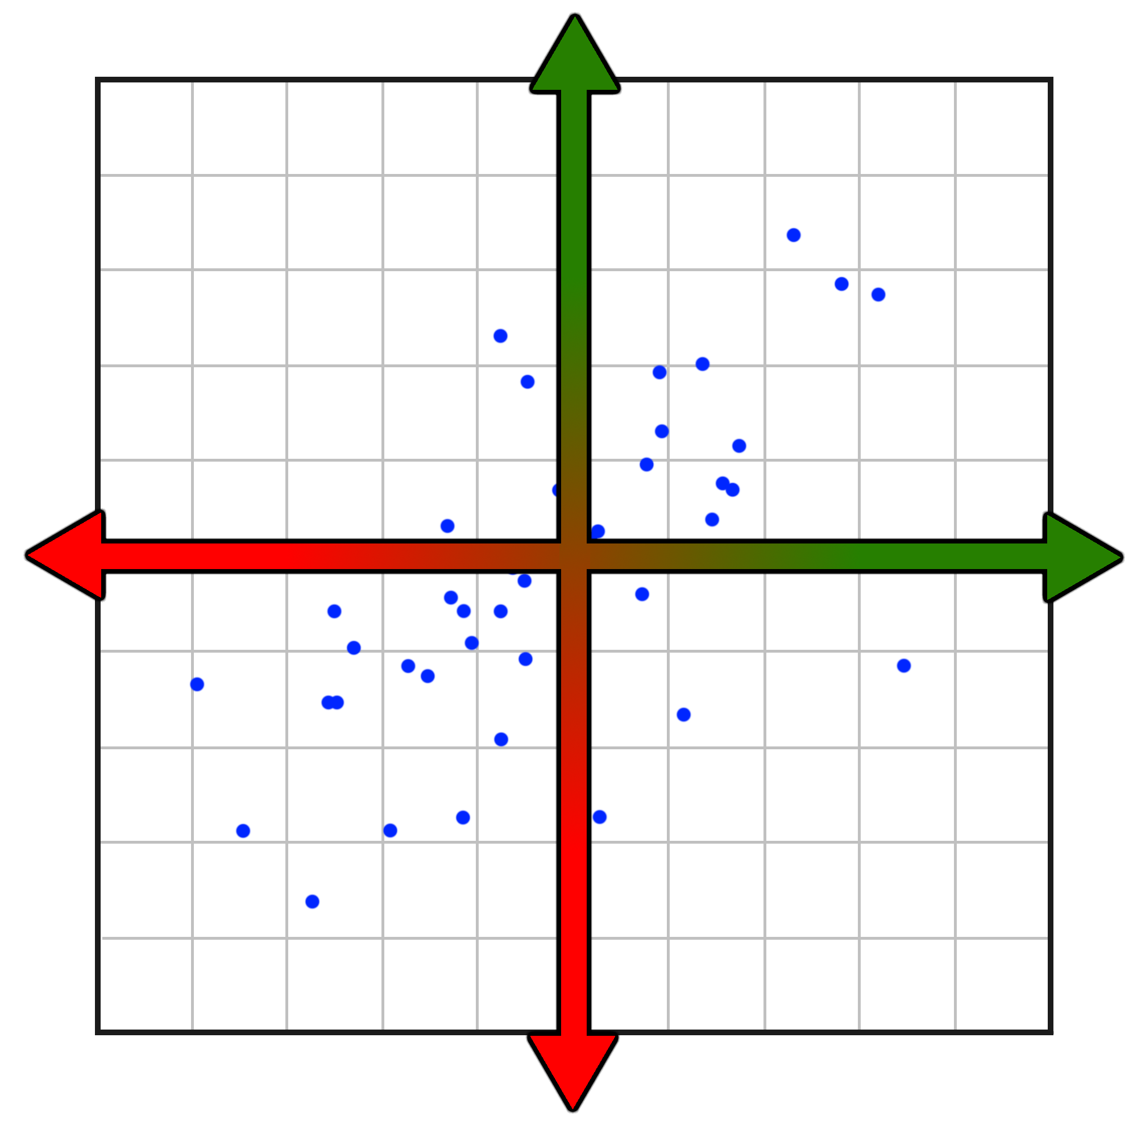













































EUROVISION ODDS vs REALITY Lauri Lüüsi Marek Murumäe
lauri.luusi@ut.ee marek.murumae@ut.ee
Project Repository
Introduction to Data Science 2022
Project E12
INTRODUCTION & GOALS
DATA, METHODS & RESULTS
Eurovision (ESC) is an annual song contest featuring participants from over 50 countries. Countries submit original songs to be performed live on TV, with a panel of judges and public voting determining the winner, who will be granted the right to host the next years’ contest.
The contest consists of two semi finals and a grand final, with the top 10 countries from each semi-final participating in the grand final, alongside the „Big Five“ and the previous years’ winner.
A number of factors determine if a song will qualify to the final, with the main feature being the country of origin. Avid viewers like us tend to often bet on well-performing countries in the hopes of earning extra money.
In this project, we aim to roughly predict the results, find if and what features affect the position of a country, and identify which countries tend to perform consistantly well or poorly in both the actual results and betting odds.
Our dataset included all ESC grand final entries from 1956 to 2018 with features such as year, running order, country, singer, title, points, place, language, love mentions, and countries’ population.
We added the missing data for 2019, 2021 and 2022, feature engineered all data to be numeric, and applied machine learning algorithms such as Support Vector Machines (SVM), Random Forest, K-Nearest Neighbors (KNN) with k=5, Lasso, and Ridge to predict points, which were ordered to find the predicted places. We grouped placements together (i.e top 3, top 10, etc.) to find the accuracy of the model.
The results varied, but our best model (KNN) was able to accurately predict the top 10 contestants with an accuracy of 58.9%. In general, trying to predict Eurovision results is pretty difficult, since everything varies from year to year, and the contests’ rules and format are changed quite often.
Average odds in contrast to average actual position
Based on ESC finals
2015-2022*
PREDICTIONS (2017)
Trained on dataset ESCDB2.csv (107 kB), K-nearest Neighbours (k=5)
Countries here are predicted to do badly, but often perform better than expected
BETTER RESULT
In 2017, the winner was actually Portugal, Bulgaria came 2nd. Our model’s prediction was off by JUST 1 place.
2
winner
Bulgaria
In the dot is the actual result
2
24
5
2
Green means the prediction was correct
TOP 3
Bulgaria was in top 3
actual place 2nd
Ukraine
was in last 10
actual place 24th
Sweden was in top 5
actual place 5th
5
White means the prediction was off by 1
WORSE ODDS
BETTER ODDS
(accuracy 0.4)
24
Red means the
prediction was off by more than 1
TOP
Correct
prediction
5
5
9
10
Wrong prediction
Sweden was in top 5
actual place 5th
Australia was in top 10
actual place 9th
Norway was in top 10
actual place 10th
(accuracy 0.4)
TOP
10
3
7
4
13
(accuracy 0.8)
1
Model predicted top 10 countries
8/10
Countries here are predicted to do well,
but often perform worse than expected
10–
WORSE RESULT
20
23
18
14
6
19
Features that affected the result
(accuracy often improved using Random Forest Classifier)
Features that had little affect
(accuracy often barely improved)
(accuracy 0.6)
20
8
17
21
11
in_english (if the song was in english or not)
singer (artists returning to the contest didn’t matter)
LAST
running_order (order the songs were performed in)
population (artists’ nation population didn’t matter)
10
16
25
15
12
26
year (in what year did the contest take place)
title (amount of words in title didn’t matter)
22
11
21
17
8
This was done by re-training and re-testing models without a particular feature and noting the changes in accuracy
(accuracy 0.5)

